Slide 1
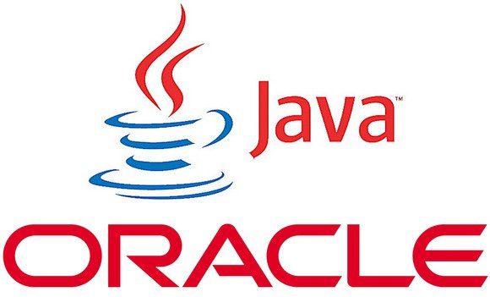

KIRANJIT
MTECH
ANDROID & IPHONE APPS

Slide 2
Point of Discussion
What & Why ?
Java is a programming language and has a platform
Application?
1.Standalone 3.Enterprise
2.Web 4.Mobile

Slide 3

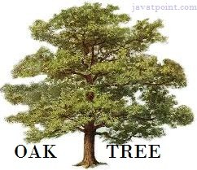
Point of Discussion
History ?
Green Team
Oak
  Java(1995)
    jdk 1.0/1.1/1.2/1.3/1.4
        J2SE 5.0/Java SE 6/7

Slide 4
Point of Discussion
Features of Java
Simple
Object-Oriented
Platform independent
Secured
Robust
Architecture neutral
Portable
Dynamic
Interpreted
High Performance
Multithreaded
Distributed

Slide 5
Point of Discussion
Oops............
Process Oriented Model :- code acts on data (object)
Object Oriented Model :- by controlling data we can access code
1.Object
2.Class
3.Inheritance
4.Polymorphism
5.Abstraction
6.Encapsulation

Slide 6
Point of Discussion
Class :-blueprint / template that describes the behaviour and states of an object.
Object :-instance of a class (created using new)
object will have its own state, and access to all of the behaviors defined by its class.
Analogy :-
Method = Behaviour
State = Instance Variable
? is Instance variable:
Each object (instance of a class) will have its own unique set of instance variables as defined in the class.

Slide 7




Example of object & class
Dog has many states:color,name & breed.
Dog has also many behaviour:
sleeping, barking, wagging
So the method declared inside class describes the behaviour.
And the class describes the behaviour & states.
States are instance variable.

Slide 8
Point of Discussion
JVM?
JRE?
JDK?
JIT ?
Note:
---------------------------------------
JVM + LIB. = JRE
JRE + DEV TOOLS = JDK
java has its own 1.API and 2.runtime environment
---------------------------------------

Slide 9
Point of Discussion
ENVIRONMENT SETUP
HELLO WORLD
ECLIPSE VS NOTEPAD

Slide 10
NO QUESTION PLZZZZ...
?

Slide 11
Gr8t now I have question
What is the base class of all classes?

Slide 12
By default all classes (if not extending) are extended by Object class.
Suppose
class Car
The compiler implicitly add
class Car extends Object
Note:-if a class is extended then its base class is its super class. eg. class Car extends Vehicle
so base class of Car is Vehicle & base class of Vehicle is object class.
Object class provides some basic methods which are common for every class like toString, finalize, notify, wait, etc.

Slide 13
So Conclusion
The java.lang.Object class is the root of the class hierarchy.
Every class has Object as a superclass. All objects, including arrays, implement the methods of this class.

